Slide 1
Final Report Writing
FYP CC101
Guideline

Slide 2
Your report must consist of
Acknowledgement
Abstract
Table of contents
List of Tables
List of Figures

Slide 3
Your report must consist of
Chapter 1: INTRODUCTION
Chapter 2: LITERATURE REVIEW
Chapter 3: METHODOLOGY
Chapter 4: RESULT AND ANALYSIS
Chapter 5: CONCLUSION
References
Appendix – User Manual, Turnitin Report, Progress Report
(Refer template report format and guideline for detail)

Slide 4
Chapter 1 Introduction
In general, this chapter starts with a general introduction or description of the project background which is relevant to the problems or issues in the project. It contains a section normally entitled “problem statement” that mentioned about the problems or issues which are to be investigated in the study, of they are interest and what the study aims to establish.
This chapter also outlines the aim and objectives of the research and briefly elaborates the strategy used to achieve the aim and objectives of the research.
This chapter should also highlight the scope and limitation of the research.
Lastly, the final part of the introduction describes how the topics will be unfolded and the order of forthcoming material.

Slide 5
Chapter subtopic (Sample)
Chapter 1
Introduction
1.1 Introduction
1.2 Problem Statement
1.3 Project Objectives
1.4 Project Scope
1.4.1 Target user
1.4.2 System scope
1.5 Conclusion

Slide 6
Chapter 2 Literature Review
This chapter describes the reserach carried out by others – related to ongoing project
Many references have to be made in this chapter
References can be taken either from books, conference papers, journal articles, magazines, thesis and / or internet
All references must be clearly recorded in the text and specified in the reference list.

Slide 7
CHAPTER 2
INTRODUCTION
PREVIOUS CASE STUDY
Example of 3 related works
Related research
Discussion
Analysis of all features in the system or previous work
Conclusion
LITERATURE REVIEW

Slide 8
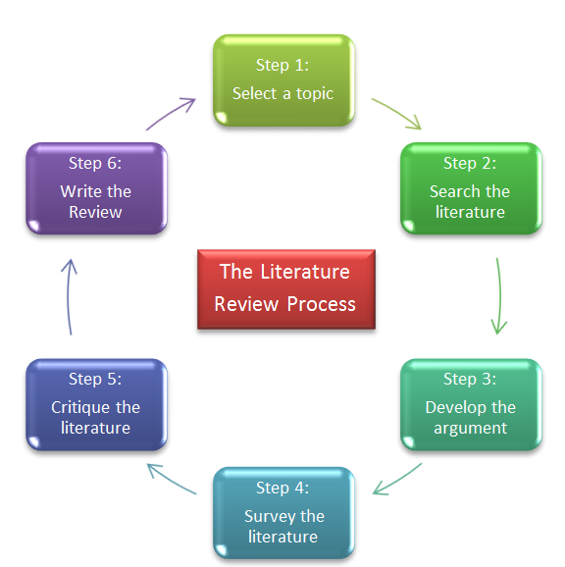
Literature review Process

Slide 9
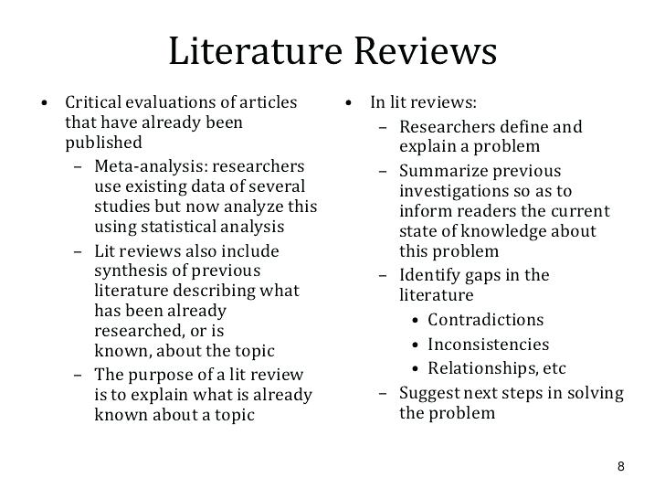
Literature review

Slide 10
Chapter subtopic (Sample)
Chapter 2
Literature Review
2.1 Introduction
2.2 Previous case study
2.2.1 Case study 1
2.2.2 Case Study 1
2.2.3 Case Study 2
2.3 Comparison
2.4 Discussion
2.5 Conclusion

Slide 11
Methodology
This chapter indicate how the project will be implemented to achieve the objectives
Content may contain methods, techniques or approaches that will be used during project / study design and implementation
This chapter also explains the justification for the use of methods or approaches as well as hardware and software requirements.
In this chapter, the expectation results of the project/study need to explain
This chapter also contains a flowchart, diagram, etc depending on your project/study.

Slide 12
CHAPTER 3
INTRODUCTION
//FOR SYSTEM / APPLICATION DEVELOPMENT
SYSTEM DEVELOPMENT METHODOLOGY
Data gathering and analysis
SYSTEM MODELLING
Use Case diagram / ERD / DFD / Class Diagram
INTERFACE DESIGN
Input Design
Output/screen Design
//FOR MULTIMEDIA DEVELOPMENT
APPLICATION DEVELOPMENT METHODOLOGY
Data gathering and analysis
APPLICATION DESIGN
Conceptual Model Design
Flow-Chart Design
Storyboard Design
CONCLUSION
METHODOLOGY

Slide 13
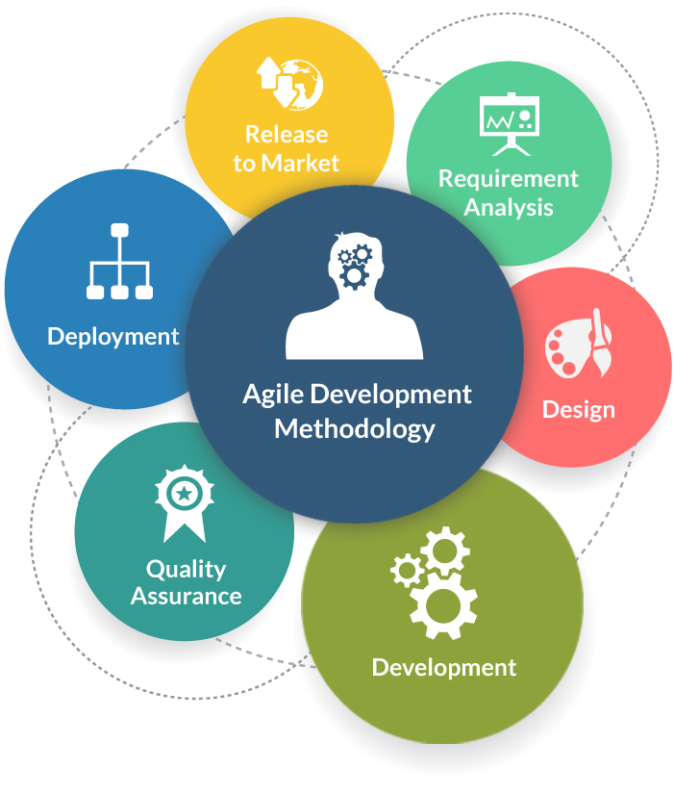
Methodology (Example)
Methodology

Slide 14
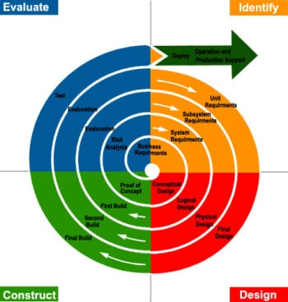
Methodology (Example)

Slide 15
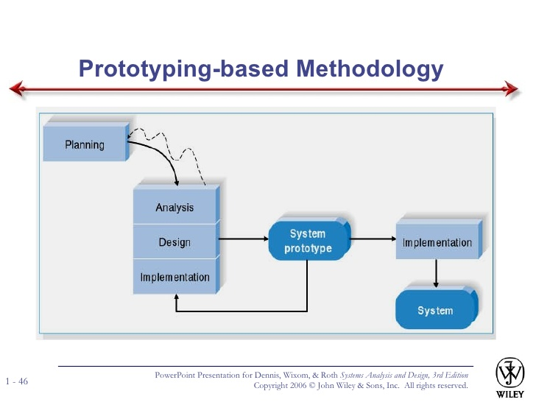
Methodology (Example)

Slide 16
Chapter 3 subtopic
Chapter 3
Literature Review
3.1 Introduction
3.2 System Development methodology
(Definition, concept and phases in Methodology)
3.3 Requirement Gathering
3.3.1 User Requirement
3.3.1.1 Analysis of user requirement
3.3.2 Project Requirement
3.3.2.1 Software and Hardware requirement

Slide 17
3.4 Interface Design
3.5 System and Application Modelling
3.5.1 Data Flow Diagram
3.5.2 Entity Relational Diagram
3.5.3 Use Case Diagram
3.5.4 Flowchart
3.5.5 Data Dictionary
3.6 Conclusion

Slide 18
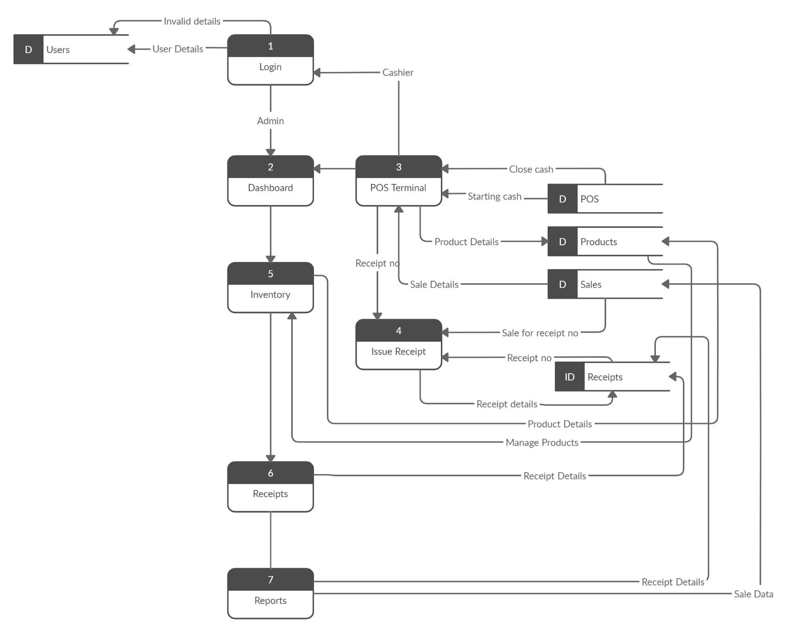
Example of Data Flow Diagram

Slide 19
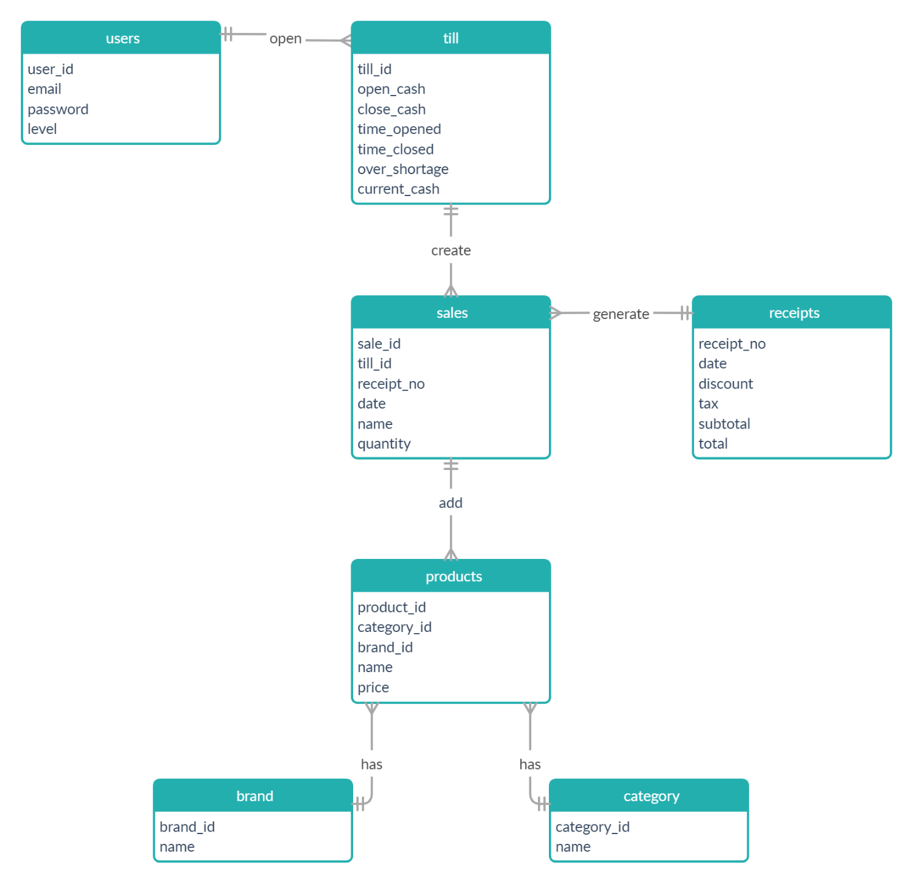
Example of Entity Relational Diagram

Slide 20
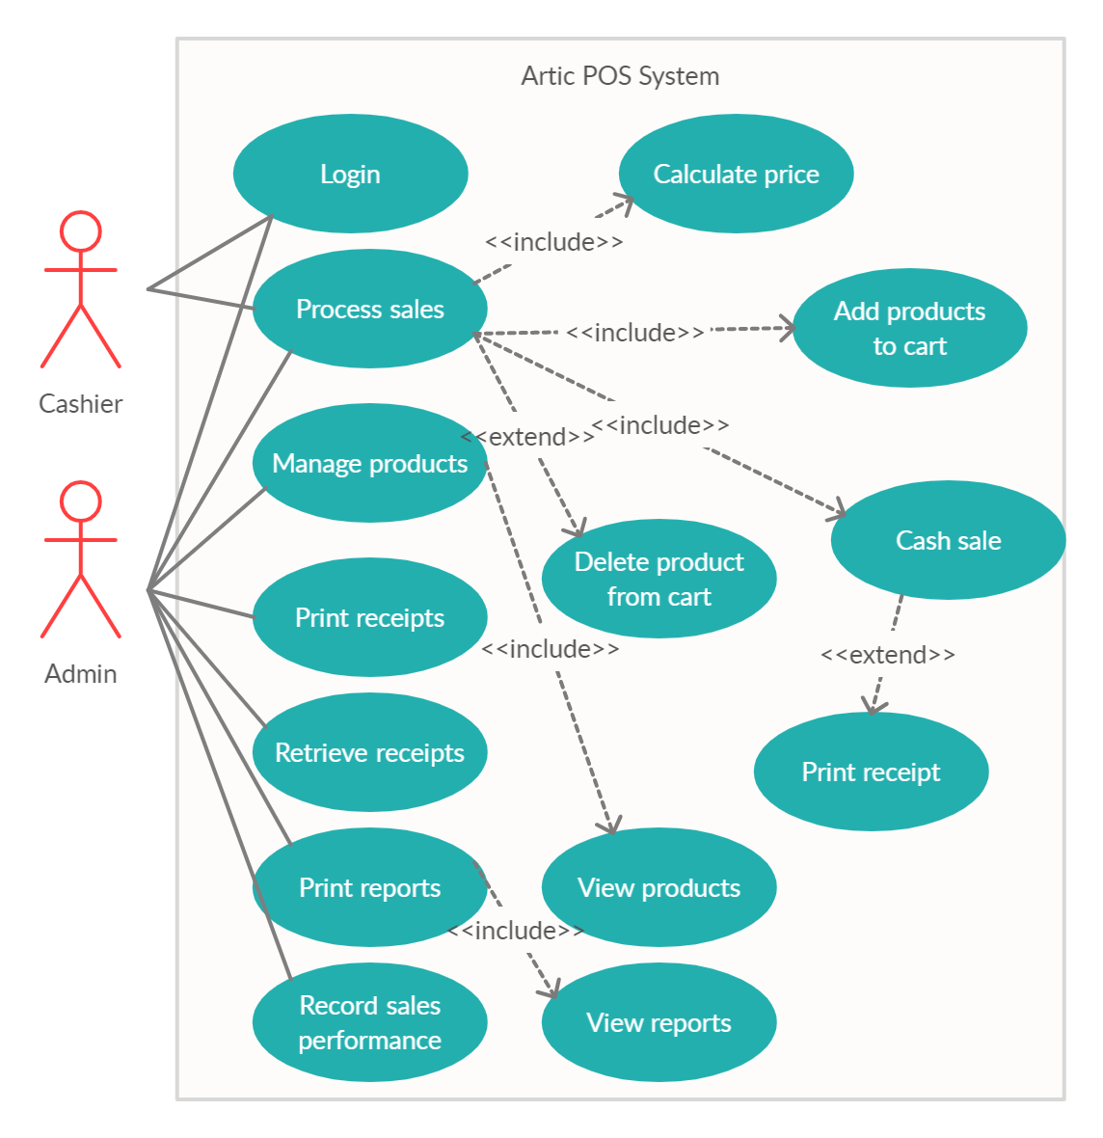
Example of Use Case Model

Slide 21
Example of Data Dictionary
Field Name | Data Type | Field Length | Constraint | Description
user_id | integer | 11 | Primary key | User ID, auto increment
Email | varchar | 40 | Not null | User login ID
Password | Varchar2 | 12 | Not null | User login pass
level | varchar | 10 | Not null | User access level

Slide 22
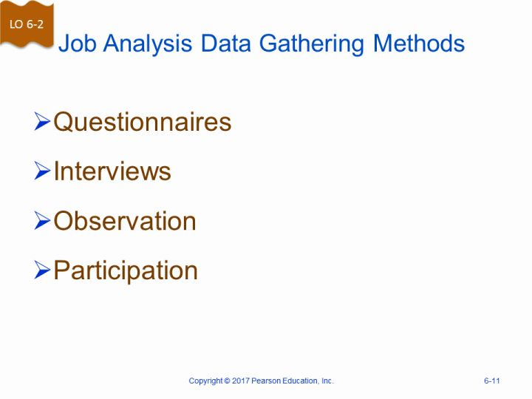
Data gathering technique
Purpose :
- To obtain user and product requirement

Slide 23
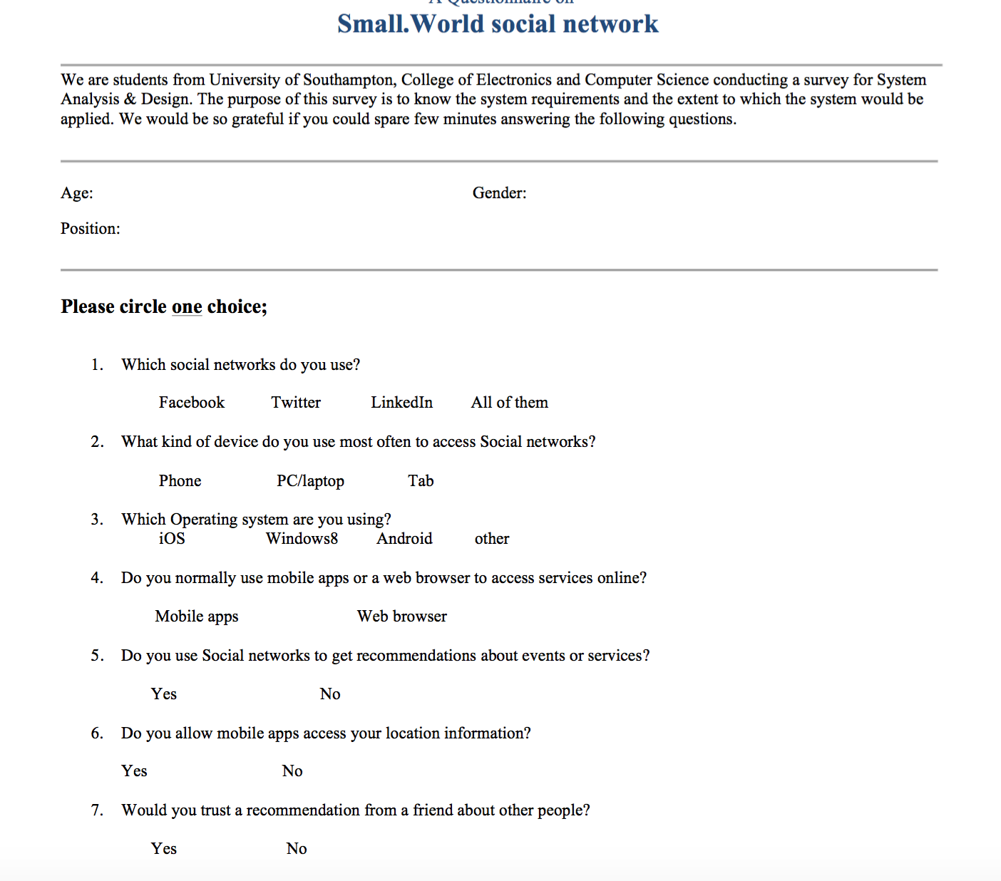
Sample Questionaire

Slide 24
Example Data gathering question
How do you manage/collect the data for all assets in this company?
How many person that involve in collecting/managing the data?
Do you agree if there is a system that can manage all the data systematically?
Do you agree if the system provide a function that can save the asset location automatically.?
Do you agree if the system able to give notification to remind company about the disposal/maintenance due date.
Do you agree if the system able to produce a report about new asset added and disposal of asset.
Do you think the system may help you to manage the data more properly from now on?
Project title: Asset Management System

Slide 25
CHAPTER 4
INTRODUCTION
SYSTEM EVALUATION / TESTING
Unit Testing
System Testing
Acceptance testing
DISCUSSION
CONCLUSION
FINDINGS AND RESULT

Slide 26
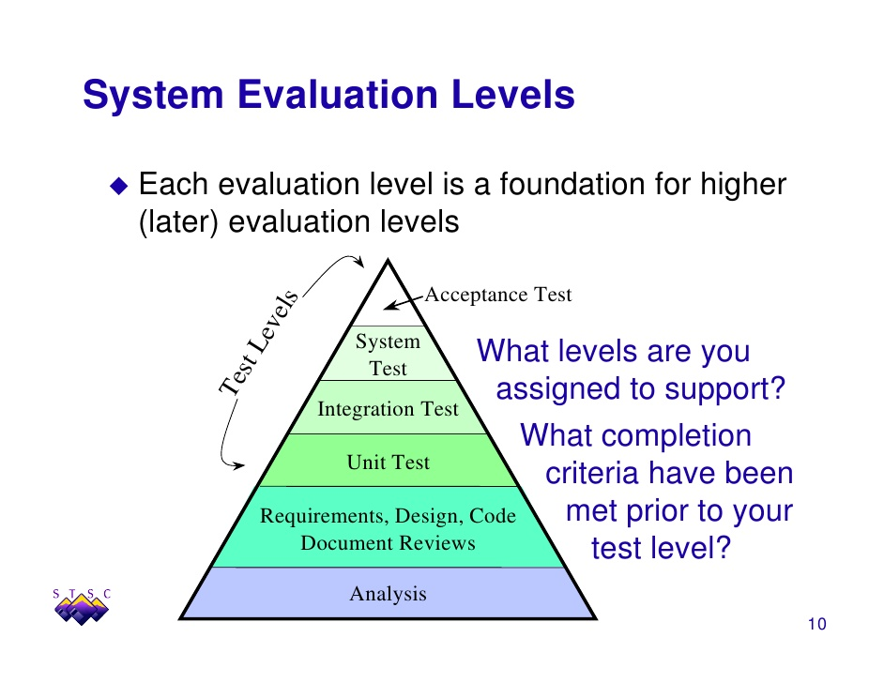
System Evaluation and Testing

Slide 27
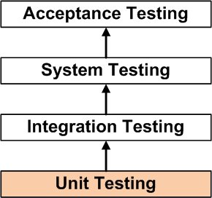
Unit Testing
Unit Testing
Is a level of software testing where individual units/ components of a software are tested. The purpose is to validate that each unit of the software/applications performs as designed. A unit is the smallest testable part of any software. It usually has one or a few inputs and usually a single output.
Testing can be done in the early phases of the software development lifecycle when other modules may not be available for integration
Fixing an issue in Unit Testing can fix many other issues occurring in later development and testing stages
Cost of fixing a defect found in Unit Testing is very less than the one found in the system or acceptance testing
Fewer bugs in the System and Acceptance testing

Slide 28
Integration Testing
Integration Testing
Is a level of software testing where individual units are combined and tested as a group. The purpose of this level of testing is to expose faults in the interaction between integrated units. Test drivers and test stubs are used to assist in Integration Testing. (Stubs are used to test the functionality of modules, whereas drivers are used when the main module is not ready.)
This testing makes sure that the integrated modules/components work properly.
Integration testing can be started once the modules to be tested are available. It does not require the other module to be completed for testing to be done, as Stubs and Drivers can be used for the same.
It detects the errors related to the interface.

Slide 29
System Testing
System Testing
is a level of software testing where a complete and integrated software is tested. The purpose of this test is to evaluate the system’s compliance with the specified requirements.

Slide 30
Acceptance Testing
Acceptance Testing
Is a level of software testing where a system is tested for acceptability. The purpose of this test is to evaluate the system’s compliance with the business requirements and assess whether it is acceptable for delivery. Divided into Alpha and Beta Testing

Slide 31
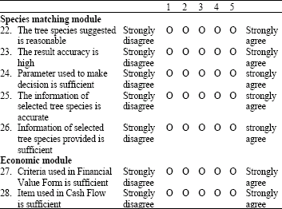
Module evaluation questionnaire

Slide 32
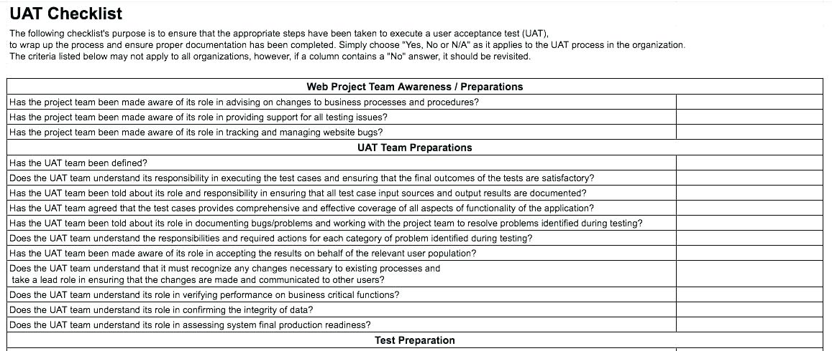
Sample of user acceptance testing

Slide 33
Sample user acceptance testing questions
Does the system do what it’s supposed to?
Do users think the system’s design matches its purpose?
What’s the first thing users would want to do on this system?
Can they do that?
When they explore the system, do they become confused at any point? (navigation)
Does anything distract them or get in their way?
Are there any features they completely ignore? (missing requirement)
Does the information architecture and navigation make sense? (Can users find what they’re looking for?)
Does the navigation/function provided helpful

Slide 34
Chapter subtopic
Chapter 4
Findings and Result
4.1 Introduction
4.2 Unit Testing
4.3 Integration Testing
4.4 System Testing
4.5 Acceptance Testing
4.6 Discussion
4.7 Conclusion

Slide 35
CHAPTER 5
INTRODUCTION
DEVELOPMENT CONSTRAINS
RECOMMENDATIONS AND FUTURE WORK
CONCLUSION
CONCLUSION

Slide 36
Chapter subtopic
Chapter 5
Conclusion
5.1 Introduction
5.2 Project Achievement
5.3 Project Constraint and limitation
5.4 Recommendation and Future Work
5.5 Conclusion

Slide 37
More
Refer Final Report Guideline and Format

